Slide 1

Statistics, Machine Learning, and AI in Accounting
An Introduction to Modern Data-Driven Approaches in Accounting
An MC Escher depiction of AI thinking about itself

Slide 2
Agenda
Introduction
Analytics in Accounting
The role of statistics & ML in accounting
How AI is revolutionizing accounting
Challenges and opportunities
Getting Started
Getting Started with Python
Conclusion
Introduction to Programming
2

Slide 3
Introduction

Slide 4

Introduction
Background
B.S: Physics, Rose-Hulman Institute of Technology
Ph.D.: Biostatistics, Indiana University School of Medicine
Computation & High-Dimensional Statistics
Family
Hobbies
Brazilian jiu-jitsu
Cycling
Work
Manager, Data Science & Artificial Intelligence
CliftonLarsonAllen LLP

Slide 5
Analytics in Accounting

Slide 6
Impact of AI
Automation
Analytics
(Statistics, AI, Machine Learning)
Insights

Slide 7
A Shifting Profession
Firm Accountant’s Shifting Workload
Client Work
Advising
Client Growth
Billing
Review
Trusted Advisor
New Client Growth
Industry Accountant’s Shifting Workload
Operational Tasks
Compliance/Risk
FP&A
Review
Strategic FP&A
Growth/Innovation Support

Slide 8
AI in Accounting
Advanced financial modeling using deep learning
Automated data entry using image recognition and large language models
Improved accuracy and reduction of human errors
Doer to thinker
Ability to handle and analyze vast amounts of data
AI Agents
Notes:
ADD EXAMPLES

Slide 9
AI in Accounting
AI Agent performs task
Human review/adjusts/ confirms
AI learns/improves
Modern AI models can reason:
Plan, execute, and review
Imagine an agent…
Preparing financial statements
Real-time auditing
Executing compliance research/tasks
Automated forecasting/reporting
Optimizing cost management
Automating payroll

Slide 10
Statistical Analysis in Accounting
Improved decision-making
Risk assessment and management
Budgeting accuracy
Fraud detection using anomaly detection
Predictive analytics for revenue forecasting

Slide 11
Statistics, Machine Learning, and AI
Statistics
Mathematics of data collection & analysis.
Describes and infers trends from data.
Machine Learning/AI
Algorithms learn from data patterns.
Types: Supervised, Unsupervised, Reinforcement.
Computer vision, Large Language Models, etc.

Slide 12
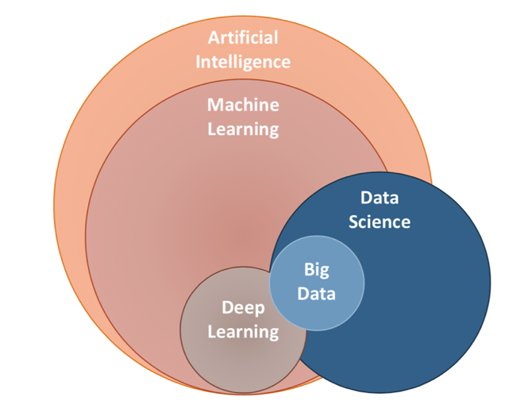
Artificial Intelligence

Slide 13
Challenges in Integrating AI and ML in Accounting
Data privacy concerns
Reliability and transparency of AI models
Need for continuous training and updating of models

Slide 14

Opportunities Ahead
AI will not replace humans; humans with AI will replace humans

Slide 15
Conclusion
The convergence of statistics, ML, and AI is inevitable in the accounting domain
Embracing these tools can lead to improved efficiency, accuracy, and decision-making
The future of accounting is data-driven

Slide 16
Introduction to Programming

Slide 17
Why Accountants Should Learn Programming
Efficiency
Automate repetitive tasks like data entry and report generation
Data Analysis
Handle large datasets easily, making better decisions with data
Adaptability
Stay competitive in a tech-driven industry
Problem Solving
Develop critical thinking and problem solving skills

Slide 18
What is Programming?
Problem Definition
Problem Analysis
Algorithm Development
Coding & Documentation
Testing & Debugging
Maintenance
Definition
Writing instructions for computers to perform specific tasks.
Why
To solve problems, automate processes, and manage data efficiently.
Key Idea
Programming is about telling the computer what to do step by step.

Slide 19
An Example: Automating Statement Reconciliation
Problem Definition
Need to automate bank statement reconciliation.
Problem Analysis
Identify data (e.g., transaction dates, amounts) to compare.
Algorithm Development
Plan how to match transactions and flag discrepancies.
Coding & Documentation
Write a Python script to automate the reconciliation.
Testing & Debugging
Run the script with sample data, fix any issues
Maintenance
Update the script as reconciliation rules or data change.

Slide 20
Introduction to Python
What is Python?:
A simple, versatile programming language.
Why Python?:
Easy to learn, widely used in data analysis, finance, and automation.

Slide 21
How a Programmer Thinks: Algorithm Development & Coding
Import Libraries
First, we need a line of code to tell the computer what tools (libraries) we need.
Example:
Read Data
Next, we tell the computer where to find the data we want to work with.
Example:
Data Cleaning
We clean or format the data to ensure consistency and usability.
Example:

Slide 22
How a Programmer Thinks: Algorithm Development & Coding
Match Transactions
We compare the transactions from two datasets to find matches or discrepancies.
Example:
Flag Discrepancies
We identify and highlight any mismatches in the data.
Example:
Output Results
Finally, we create a report or output the results to share with others.
Example:

Slide 23
Why Does Python Code Look Like This?
Precision
Programming requires exact instructions; every detail matters.
Syntax
Python has its own grammar, just like a language, to tell the computer what to do.
Readability
Python is designed to be easy to read, even for beginners.
Indentation
The spacing (indentation) you see is important in Python; it shows the structure of the code.
Comments
Text after # is ignored by the computer—it's just notes for humans to understand the code.

Slide 24
Getting Started

Slide 25
Getting Started with Python
Installing Python (Jupyter Notebook)
Download Anaconda:
https://www.anaconda.com/download
Installation:
Run the Anaconda installer
Documentation & Help:
Anaconda Navigator
Jupyter Documentation

